Slide 2

How to
Stay Sane
c
As a Support Engineer
Whhender
July 2020

Slide 3
We are recording today
We will have a non-Recorded
Time at the end for Questions
But also, Feel Free to ping me Anytime
Whhender
I’ve been there. I’d love to talk.

Slide 4
As Usual
All of this is on the wiki
a
a
And This presentation will be too!
Just open up the wiki and search:
‘Survival Guide’

Slide 5
Thank you!
To All the Engineers who Contributed to this Deck
Alex Blaine
Julie O’Brien
Sundar Easwaran
Silvia Cimpurean
Olga Molocenco
Sumit Biswas
Azith Ganti
Pedro Martins
Reach out to these engineers and other senior engineers if you have questions!

Slide 6
d
Agenda
Good Behaviors
Case Cool
Tools & Tricks

Slide 7
This presentation is not Here to help you become the most best, most organized Engineer ever.
a
a
Instead
If you feel like you are drowning in cases,
Try these Steps.
Find out what works for you.

Slide 8
a
Good Behaviors
Things you can start doing right now to make your life better.
Lessons that I have personally cried over more than once before I started putting them into practice

Slide 9
Sign Off
1.
when your shift ends.
We’re a global company. that means people are working in other time zones! If your customer really needs something, those other engineers can and should help them. Just leave that contact information in your signature or out of office and leave your email until tomorrow.
Ask For Help
2.
when you get stuck.
We’re all working together! Don’t wait until you’ve hit a wall of frustration. Reach out to your teammates! They might have helpful Ideas, and at very least they know what it’s like to be stuck and will gladly let you Vent.

Slide 10
Organize
3.
your cases and inbox.
Organization Looks different for everyone. I used 5000000 different categories in Case Buddy to Let me know what is Going on with my cases at a glance, and I used OL Helper to Narrow the scope of what I need to keep in my inbox. Find a system that works for you!
Take Vacations
4.
to stay refreshed.
Seriously Though. Microsoft gives us good vacation days. Make sure you use them! Be that by taking of a Friday Every Few Weeks or Saving up and taking two weeks off at a time, make sure you are using those vacation days to keep yourself charged. Sometimes it just helps to have a break written in the calendar, so you know when you’ll be able to Slow Down.

Slide 11
Find a Rhythm
5.
that works for you.
Everyone has a different work Rhythm. My brain works best in the morning, so I keep those hours open to get my best work done. I also write out my Entire schedule for the day right at the beginning. Find a flow that feels right!
Take Breaks
6.
during the day.
Stop working to eat your lunch. Take a walk after a long customer meeting. Take 15 minutes after doing research. A lunch hour is Built into your schedule every day. Make sure you use it! Find time to Step away and refocus.

Slide 12
a
Case Cool
How to stay in control when you’re active on a case.
And let’s face it, it’s never just one case at a time

Slide 13
1. You don’t have to know every answer.
2. If you’re not getting anywhere,
take a break.

Slide 14
3. Be clear. Set honest expectations.
4. Ask for clarity if you don’t understand.
5. Stay calm and collected in front of
your customer.

Slide 15
Most cases aren’t make or break on technical knowledge. All your customers want is for you to understand their problem and be dedicated to fixing it.

Slide 16
a
Tools & Tricks
How the best in the biz get it done.
The only things that have stood between me and utter case Chaos

Slide 17
How to Sign Off
Trust your global teammates.
Good notes.
Out of Office Messages
Clarity with your customers.

Slide 18
Ask for Help
Teams/Ava
Peers
TAs/SMEs/PG
Mentor

Slide 19
How to Organize
Case Categories
Internal Title
OLHelper
Review your cases regularly.

Slide 20
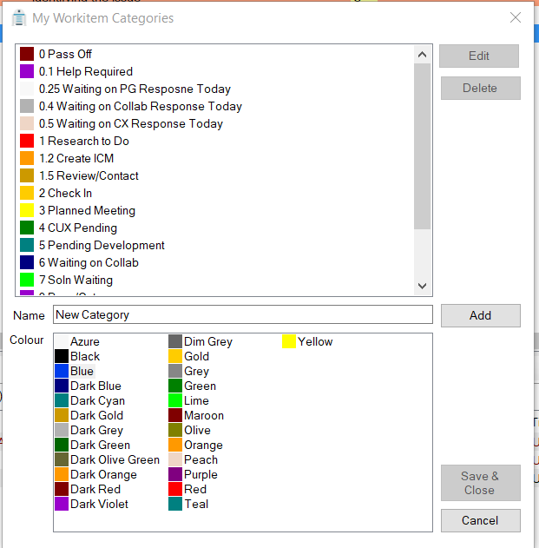
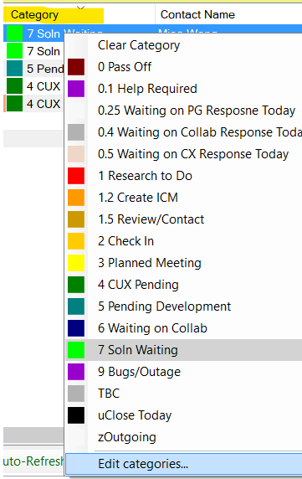
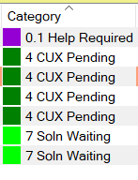
Categories
Case Buddy
Right Click

Slide 21
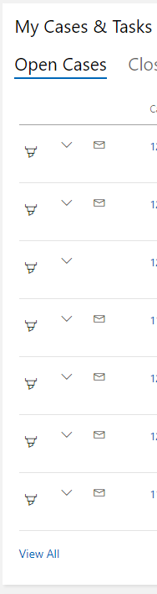
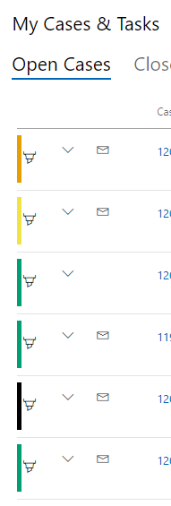
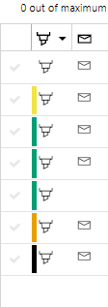
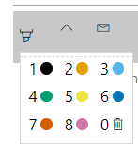
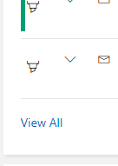
Categories
Service Desk
Click

Slide 22
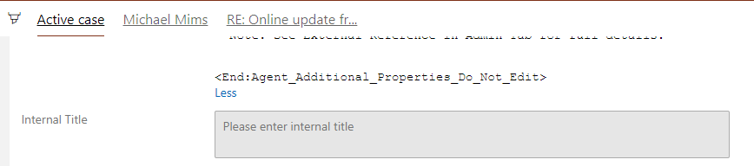
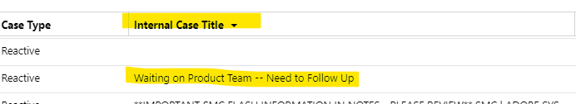
Internal Title
Service Desk
Case Buddy
Customer Can’t See This
(But Your Teammates Can)

Slide 23
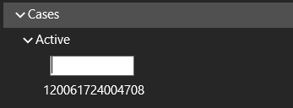
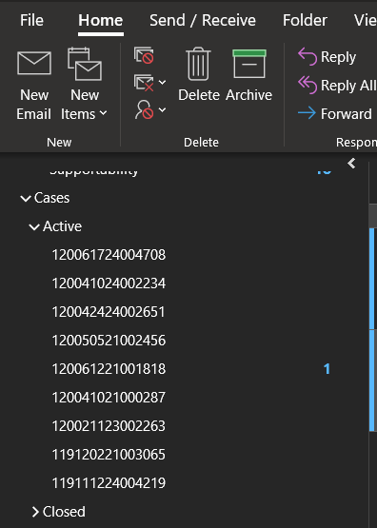
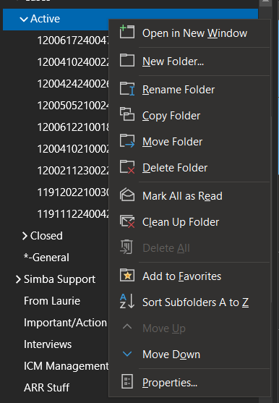
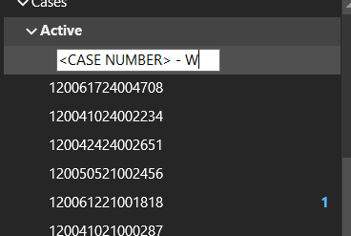
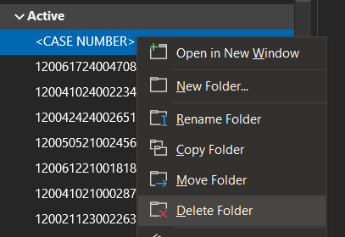
OL Helper
Outlook Extension to Organize Your Inbox
Right Click

Slide 24
Find your Flow
Pomodoro Technique
Just 15 Minutes to Start Hard Tasks
Focus Time/Focus Apps
Get Into a Routine

Slide 25
This presentation is not Here to help you become the most best, most organized Engineer ever.
a
a
Instead
If you feel like you are drowning in cases,
Try these Steps.
Find out what works for you.

Slide 26
If you’re working all the time and are exhausted:
If you feel like you have too many cases to know what’s going on anymore:
If you feel lost on some topics or problems:
If customer interactions are driving you crazy:
Sign Off On Time, Take Breaks in the Day, Eat Lunch, Plan a Vacation
Use Case Categories, Internal Titles, change how you take notes, Control your Schedule
Ask for help, Find a mentor, ask for training days
Plan your steps, Leave Unproductive calls, set clear boundaries

Slide 27
As Usual
All of this is on the wiki
a
a
And This presentation will be too
Just open up the wiki and search:
‘Survival Guide’

Slide 28
If you want to add your own
Best practices and experiences for Other Engineers to Learn from
Please do!!
Add anything to the Section Called
‘lessons We’re Learning’

Slide 29
If you forget the rest of this presentation, Remember This:
Stop Working After Your Hours
a
a

